Slide 1
Diffusion in Networks
Spread of ideas, opinions, behaviors, etc. from node to node

Slide 2
Two Types of Spreading in Networks
Diffusion
The spread of new ideas, opinions, behaviors, etc.
People make decisions whether or not to adopt a new technology or political view.
In making such decisions, people are influenced by prior adapters, especially by their neighbors in social networks.
Epidemics
The spread of diseases over networks of contact between nodes.
The nodes can be people, animals, plants, or even computers.
In the case of diseases, the disease transmission is not a decision-making process.

Slide 3
Models of Diffusion
Threshold models
How new ideas, opinions, behaviors, etc. propagate through a social network? We will define a class of so-called threshold models.
Application: marketing strategy
We want to maximize the spread of a new product (for example, a new cell phone) in a given social network.
Can we find a “small subset” of initial adopters that triggers a large cascade of further adoptions?

Slide 4
Fractional Threshold Model
Simplest Version

Slide 5
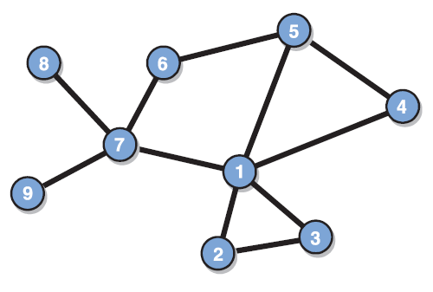


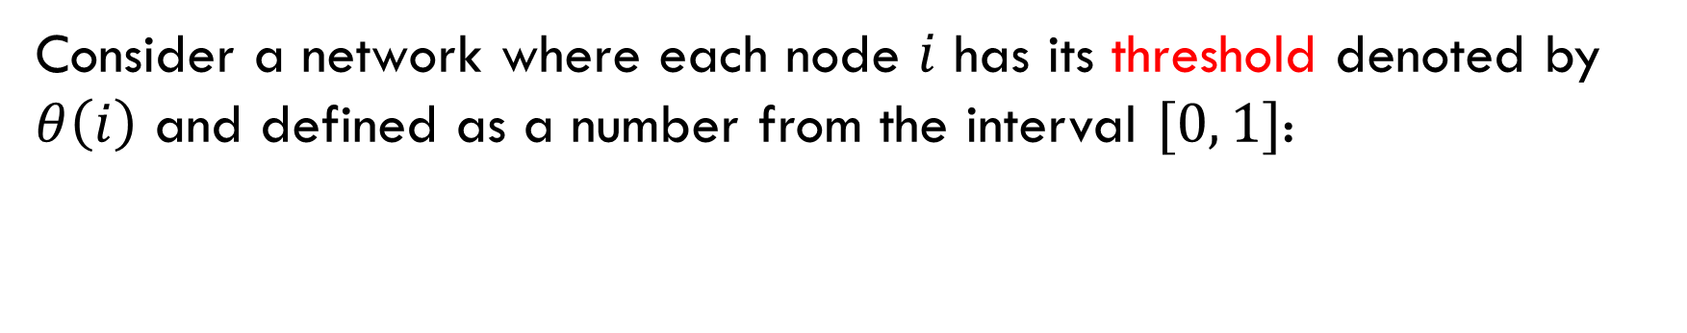








Consider a network where each node $i$ has its threshold denoted by $θ\left(i\right)$ and defined as a number from the interval $[0, 1]$:
$$0≤θ\left(i\right)≤1.$$
$$2/5$$
$$1/2$$
$$2/3$$
$$1/3$$
$$3/5$$
$$2/5$$
$$1/2$$
$$1/3$$
$$1/2$$

Slide 6
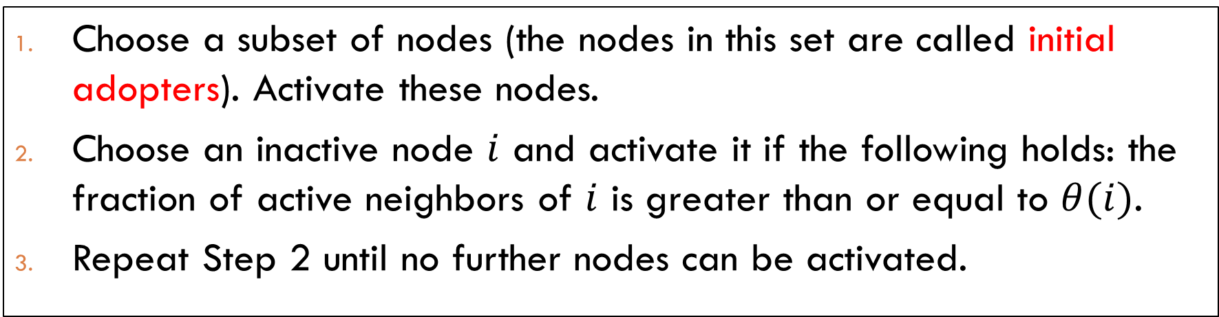
Iteration Process
Given a network with thresholds, which of its nodes will eventually adopt an innovation? In the beginning, every node is inactive, which means that the node did not adopt the innovation. Then activation proceeds as follows:
Choose a subset of nodes (the nodes in this set are called initial adopters). Activate these nodes.
Choose an inactive node $i$ and activate it if the following holds: the fraction of active neighbors of $i$ is greater than or equal to $θ(i)$.
Repeat Step 2 until no further nodes can be activated.

Slide 7
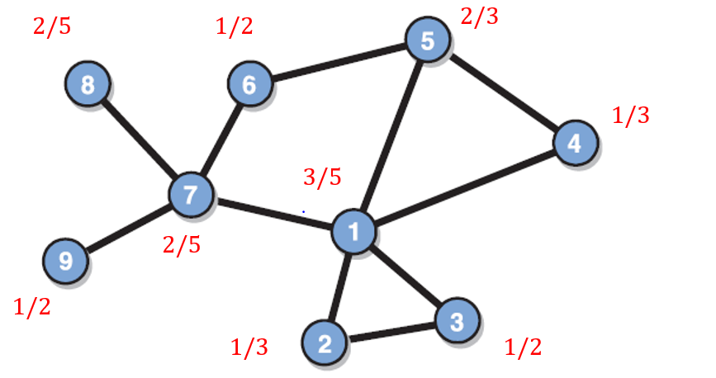

Initial adopters: $\{1\}$.
Activate $2.$
Activate 3.
Activate 4.
Activate 5.
Activate 6.
Activate 7.
Activate 8.
Activate 9.

Slide 8

Initial adopters: $\{7\}$.
Activate $6.$
Activate 8.
Activate 9.

Slide 9

Initial adopters: $\{4, 7\}$.
Activate $6.$
Activate 5.
Activate 1.
Activate 2.
Activate 3.
Activate 8.
Activate 9.

Slide 10
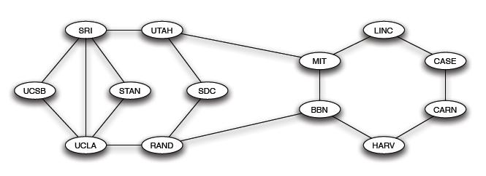
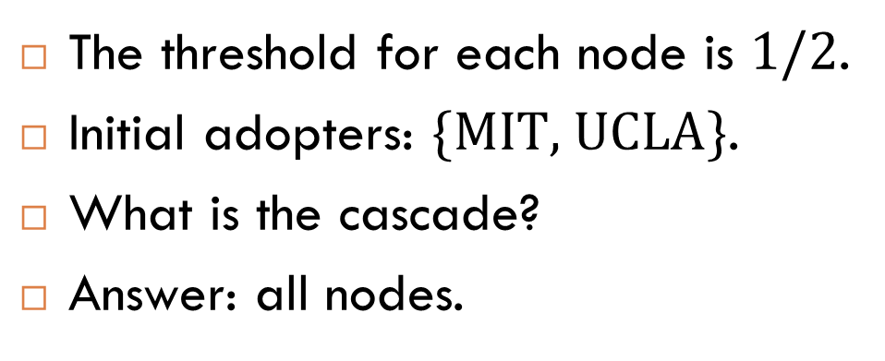
Exercise
The threshold for each node is $1/2$.
Initial adopters: $\{\text{MIT}\text{, }\text{UCLA}\}$.
What is the cascade?
Answer: all nodes.

Slide 11
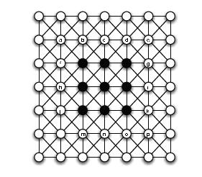
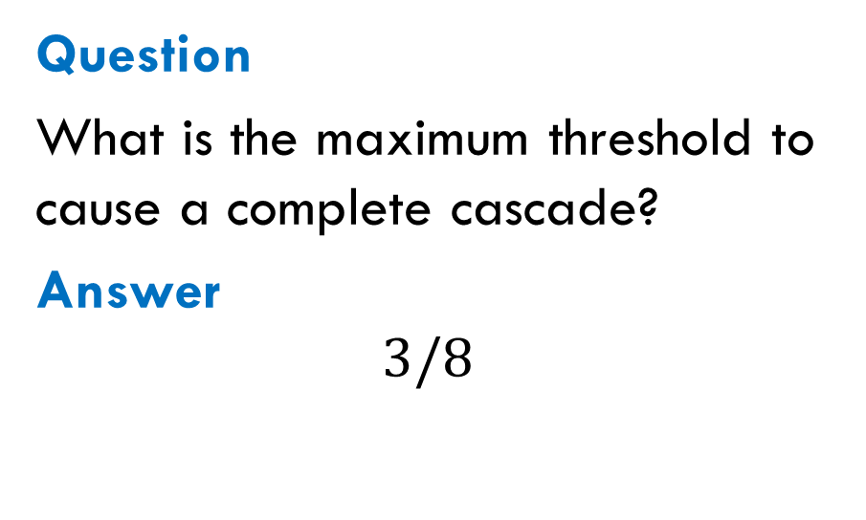
Another Exercise
Question
What is the maximum threshold to cause a complete cascade?
Answer
$$3/8$$

Slide 12
Linear Threshold Model

Slide 13
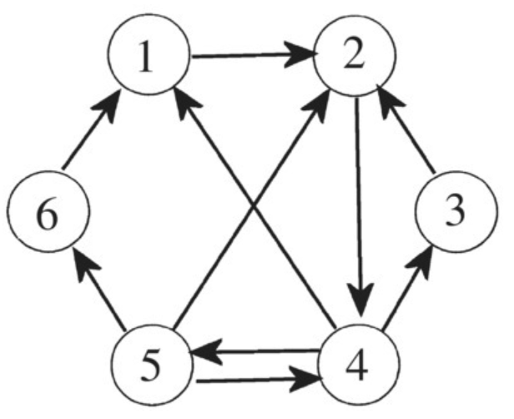
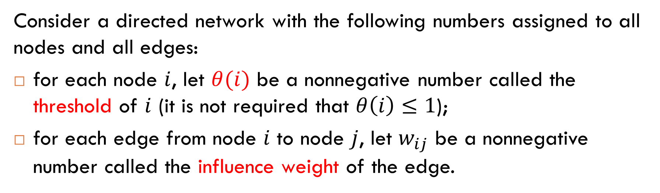
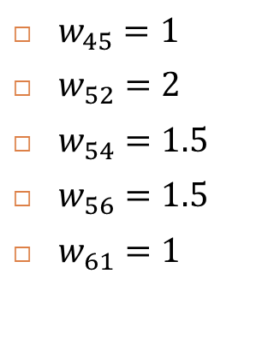
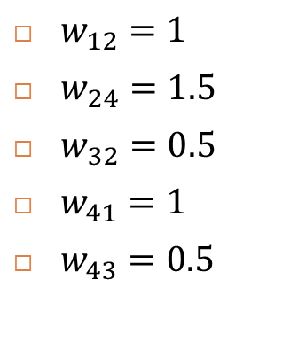
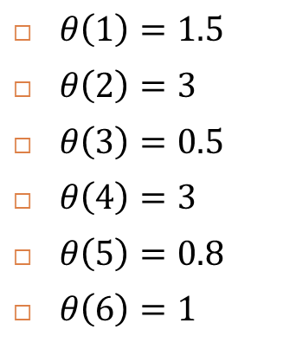
Consider a directed network with the following numbers assigned to all nodes and all edges:
for each node $i$, let $θ(i)$ be a nonnegative number called the threshold of $i$ (it is not required that $θ\left(i\right)≤1$);
for each edge from node $i$ to node $j$, let $w_{ij}$ be a nonnegative number called the influence weight of the edge.
$θ\left(1\right)=1.5$
$θ\left(2\right)=3$
$θ\left(3\right)=0.5$
$θ\left(4\right)=3$
$θ\left(5\right)=0.8$
$θ\left(6\right)=1$
$w_{12}=1$
$w_{24}=1.5$
$w_{32}=0.5$
$w_{41}=1$
$w_{43}=0.5$
$w_{45}=1$
$w_{52}=2$
$w_{54}=1.5$
$w_{56}=1.5$
$w_{61}=1$

Slide 14
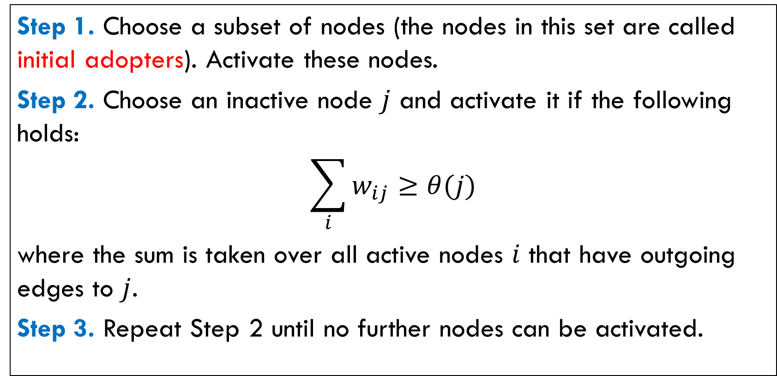
Iteration Process
Step 1. Choose a subset of nodes (the nodes in this set are called initial adopters). Activate these nodes.
Step 2. Choose an inactive node $j$ and activate it if the following holds:
$$\sum_{i}{w_{ij}≥θ(j)}$$
where the sum is taken over all active nodes $i$ that have outgoing edges to $j$.
Step 3. Repeat Step 2 until no further nodes can be activated.

Slide 15
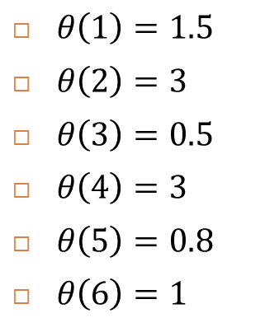
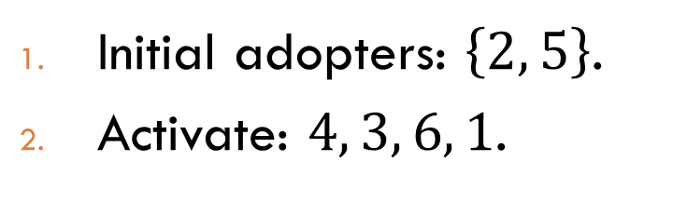

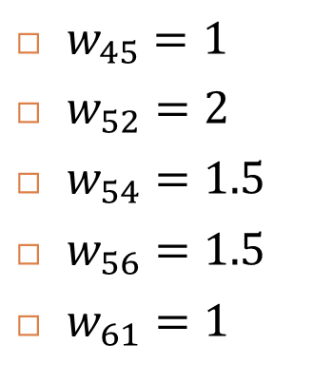
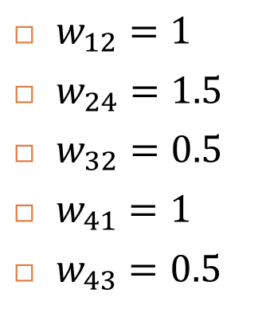
Examples
$θ\left(1\right)=1.5$
$θ\left(2\right)=3$
$θ\left(3\right)=0.5$
$θ\left(4\right)=3$
$θ\left(5\right)=0.8$
$θ\left(6\right)=1$
$w_{12}=1$
$w_{24}=1.5$
$w_{32}=0.5$
$w_{41}=1$
$w_{43}=0.5$
$w_{45}=1$
$w_{52}=2$
$w_{54}=1.5$
$w_{56}=1.5$
$w_{61}=1$
Initial adopters: $\left\{4\right\}$.
Activate: $3, 5, 6, 1, 2.$
Initial adopters: $\left\{2, 5\right\}$.
Activate: $4, 3, 6, 1$.

Slide 16


More Examples
$θ\left(1\right)=1.5$
$θ\left(2\right)=3$
$θ\left(3\right)=0.5$
$θ\left(4\right)=3$
$θ\left(5\right)=0.8$
$θ\left(6\right)=1$
$w_{12}=1$
$w_{24}=1.5$
$w_{32}=0.5$
$w_{41}=1$
$w_{43}=0.5$
$w_{45}=1$
$w_{52}=2$
$w_{54}=1.5$
$w_{56}=1.5$
$w_{61}=1$
Initial adopters: $\left\{1, 5\right\}$.
Activate: $2, 4, 3, 6.$
Initial adopters: $\left\{3, 5\right\}$.
Activate: $6$.

Slide 17
Finding a Good Set of Initial Adopters

Slide 18
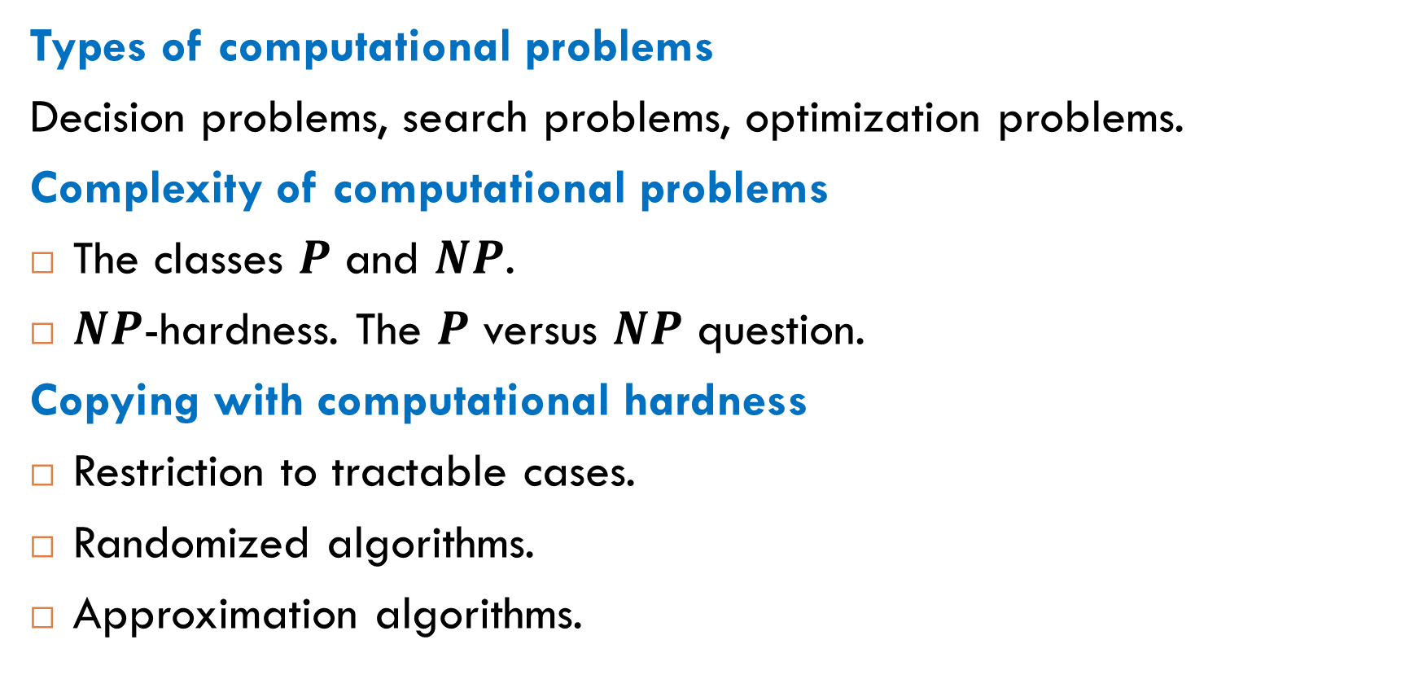
Computational Problems
Types of computational problems
Decision problems, search problems, optimization problems.
Complexity of computational problems
The classes $P$ and $NP$.
$NP$-hardness. The $P$ versus $NP$ question.
Copying with computational hardness
Restriction to tractable cases.
Randomized algorithms.
Approximation algorithms.

Slide 19
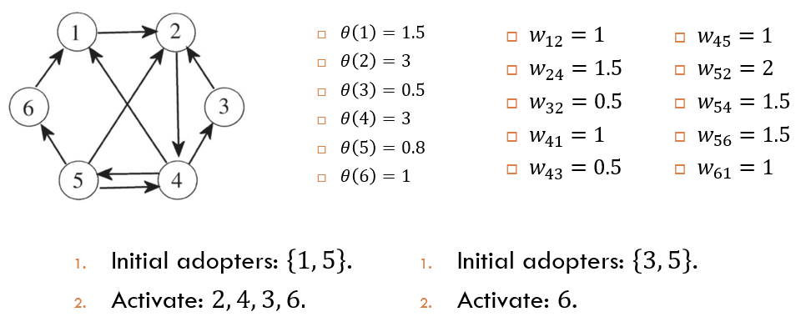
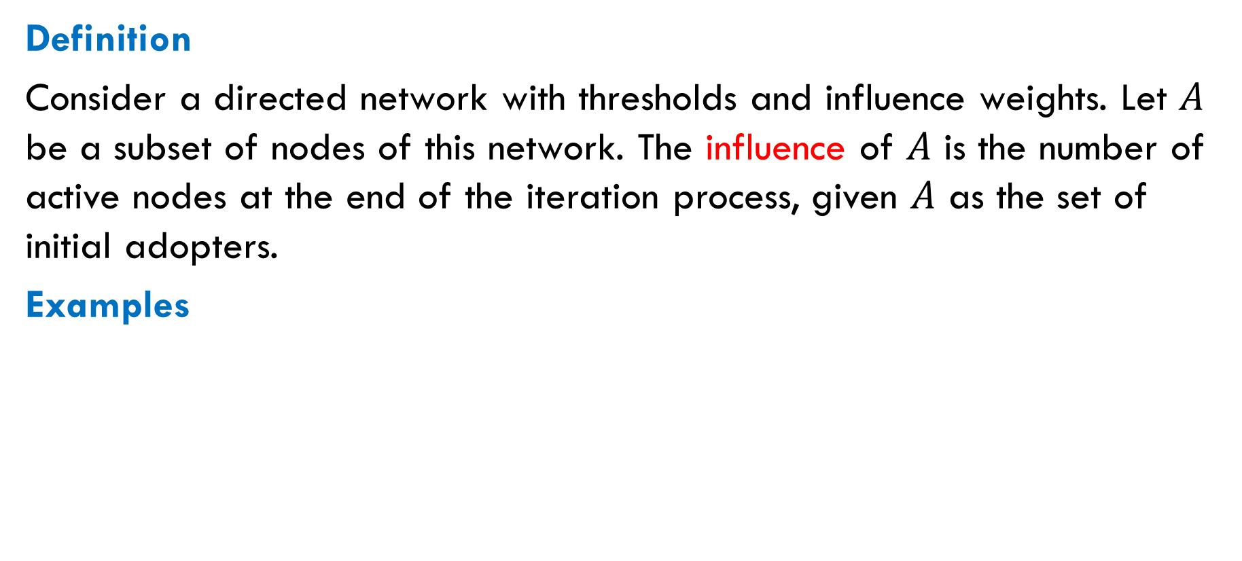
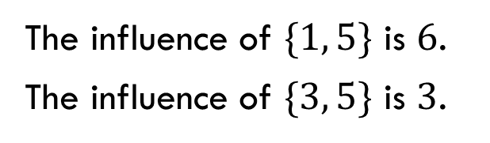
Influence
Definition
Consider a directed network with thresholds and influence weights. Let $A$ be a subset of nodes of this network. The influence of $A$ is the number of active nodes at the end of the iteration process, given $A$ as the set of initial adopters.
Examples
The influence of $\{1, 5\}$ is $6$.
The influence of $\{3, 5\}$ is $3$.

Slide 20
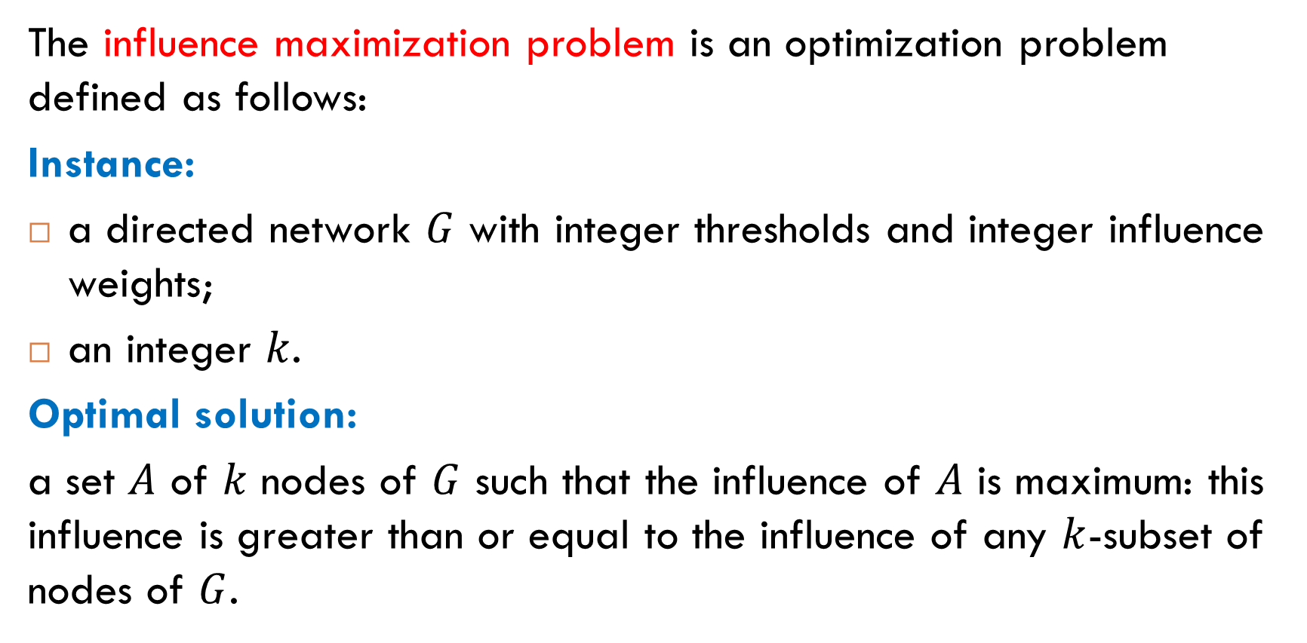
Influence Maximization
The influence maximization problem is an optimization problem defined as follows:
Instance:
a directed network $G$ with integer thresholds and integer influence weights;
an integer $k$.
Optimal solution:
a set $A$ of $k$ nodes of $G$ such that the influence of $A$ is maximum: this influence is greater than or equal to the influence of any $k$-subset of nodes of $G$.

Slide 21
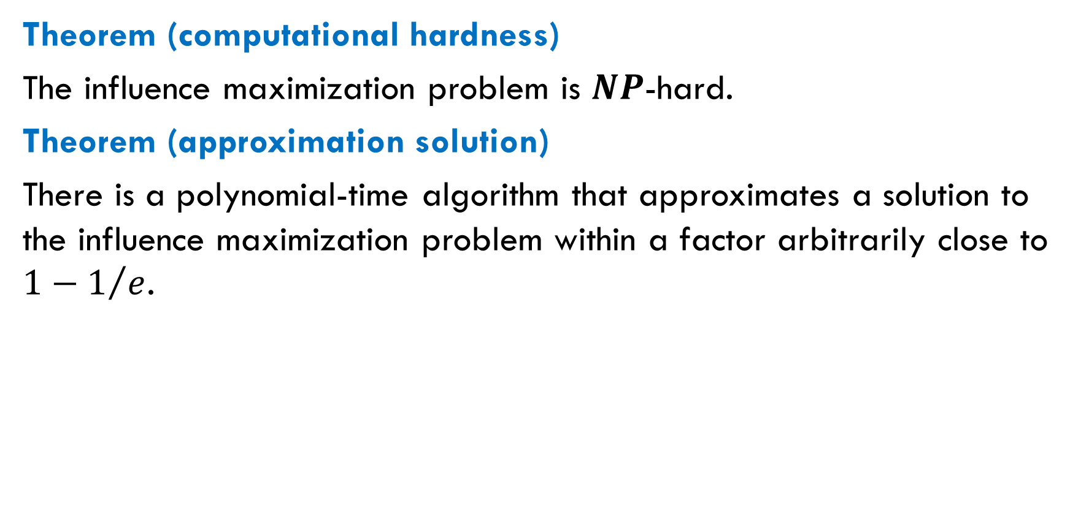
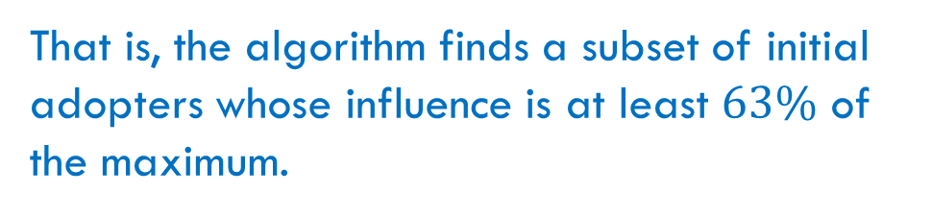
Results
Theorem (computational hardness)
The influence maximization problem is $NP$-hard.
Theorem (approximation solution)
There is a polynomial-time algorithm that approximates a solution to the influence maximization problem within a factor arbitrarily close to $1−1/e$.
That is, the algorithm finds a subset of initial adopters whose influence is at least $63\%$ of the maximum.
Notes:
Approximation factor: $1−1/e−ε$ for any $ε>0$.

Slide 22
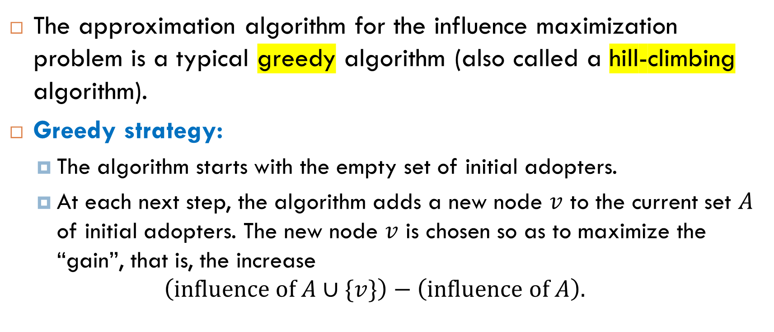
Approximation Algorithm
The approximation algorithm for the influence maximization problem is a typical greedy algorithm (also called a hill-climbing algorithm).
Greedy strategy:
The algorithm starts with the empty set of initial adopters.
At each next step, the algorithm adds a new node $v$ to the current set $A$ of initial adopters. The new node $v$ is chosen so as to maximize the “gain”, that is, the increase
$$\left(\text{influence} \text{of} A∪\{v\}\right)−\left(\text{influence} \text{of} A\right).$$
Notes:
Approximation factor: $1−1/e−ε$ for any $ε>0$.

Slide 23

Reading
Section 7.1.1
Article “Maximizing the Spread of Influence
through a Social Network”.

